Slide 1


Python programming
How to set up Python

Slide 2
Tl;dr
Quick version - Installing Python
It’s free. Visit www.python.org
Be sure to check Add Python 3.7 to PATH
Install a programming editor, e.g. atom.io
Open the Windows CMD prompt (or shell on Mac or Linux)
Type - python
Notes:
Please do not reduce the font size as this is the recommended size for mobile phone users.
2

Slide 3
Step by step
How to install and start using Python
Do you have permission?
These instruction assume you have permission to install software on a computer. By this I mean that you are allowed to, and that you have the necessary computer security rights, for example you have “administrator” rights.
Notes:
Please do not reduce the font size as this is the recommended size for mobile phone users.
3

Slide 4
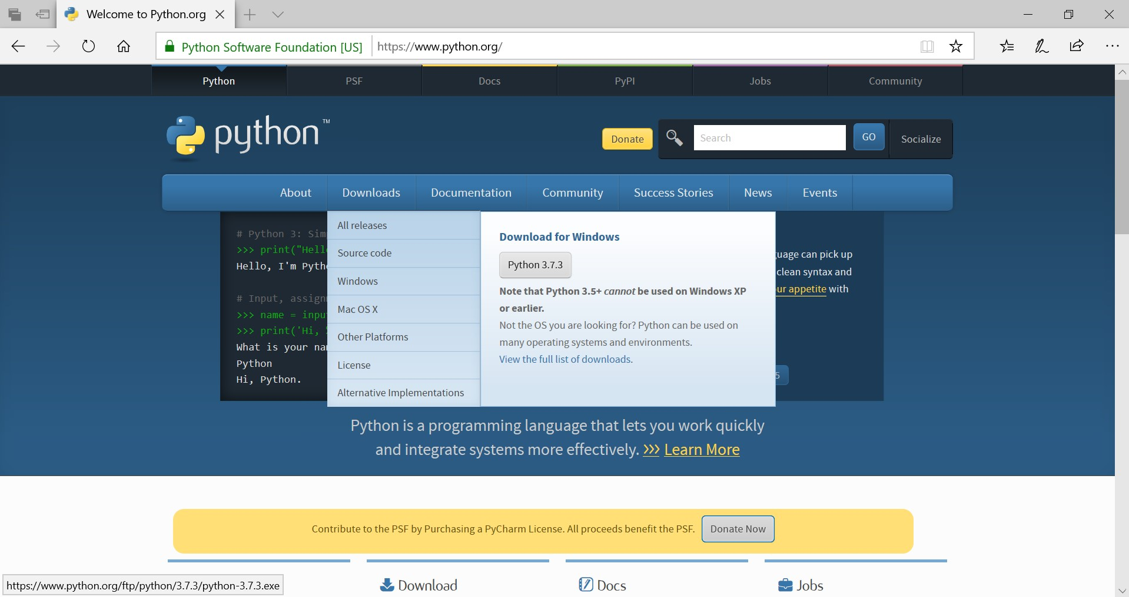
Step 1 – Download Python
Visit www.python.org
Notes:
Please do not reduce the font size as this is the recommended size for mobile phone users.
4

Slide 5
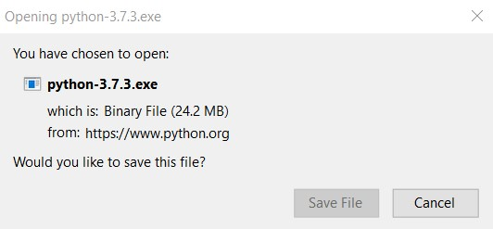
Step 2 – Download Python
Save the file (note version numbers change)
Notes:
Please do not reduce the font size as this is the recommended size for mobile phone users.
5

Slide 6
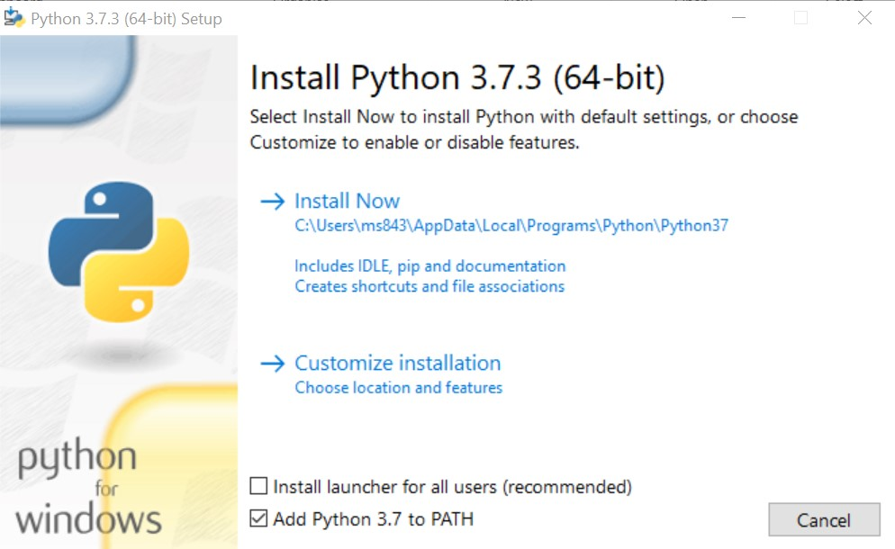
Step 3 – Install Python
Check - Add Python 3.7 to PATH
Click on – Install Now
Notes:
Please do not reduce the font size as this is the recommended size for mobile phone users.
6

Slide 7
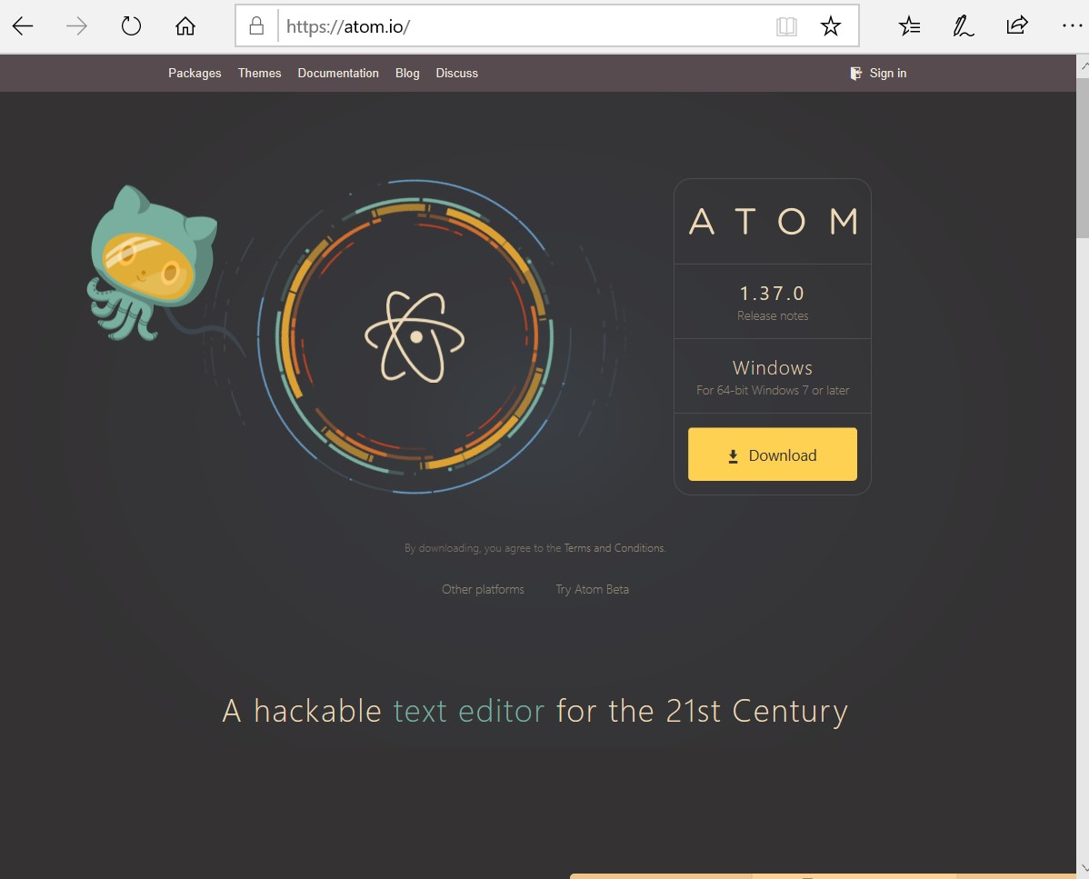
Step 4 – Download Atom Editor
Visit atom.io
Notes:
Please do not reduce the font size as this is the recommended size for mobile phone users.
7

Slide 8

Step 5 – Install Atom
Notes:
Please do not reduce the font size as this is the recommended size for mobile phone users.
8

Slide 9
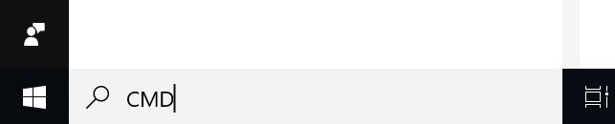
Step 6 Open the CMD Prompt
On Windows computers. Mac is different.
Notes:
Please do not reduce the font size as this is the recommended size for mobile phone users.
9

Slide 10
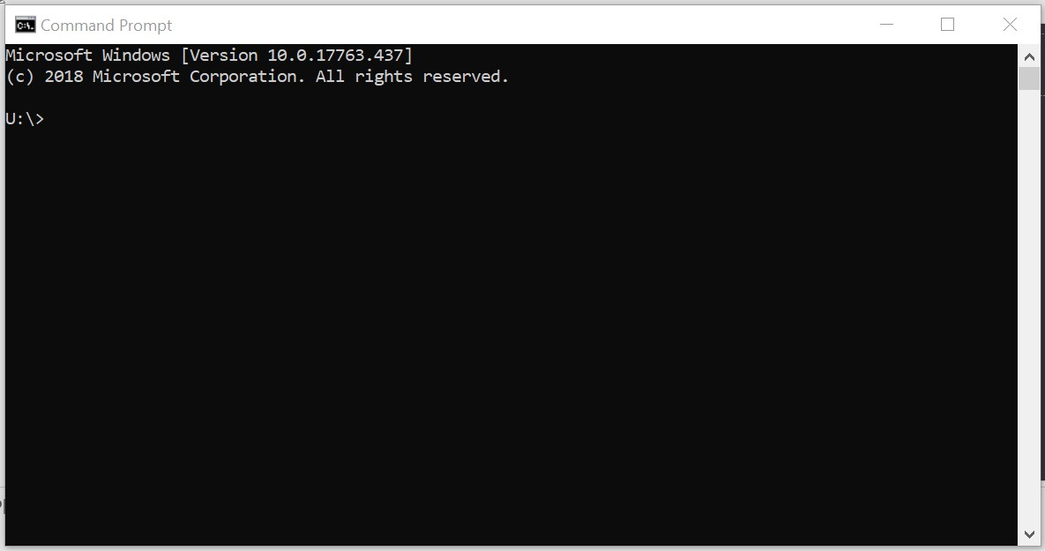
Step 7 Practice using “the shell”
Also called the “terminal”, or
“command prompt”
Notes:
Please do not reduce the font size as this is the recommended size for mobile phone users.
10

Slide 11
Step 8
Run Python in “interactive mode”
U:\>python
Python 3.7.3 (v3.7.3:ef4ec6ed12, Mar 25 2019, 22:22:05) [MSC v.1916 64 bit (AMD64)] on win32
Type "help", "copyright", "credits" or "license" for more information.
>>> help()
Welcome to Python 3.7's help utility!
If this is your first time using Python, you should definitely check out
the tutorial on the Internet at https://docs.python.org/3.7/tutorial/.
Notes:
Please do not reduce the font size as this is the recommended size for mobile phone users.
11

Slide 12
Step 9
Quit Python
U:\>python
Python 3.7.3 (v3.7.3:ef4ec6ed12, Mar 25 2019, 22:22:05) [MSC v.1916 64 bit (AMD64)] on win32
Type "help", "copyright", "credits" or "license" for more information.
>>> quit()
U:\>
Notes:
Please do not reduce the font size as this is the recommended size for mobile phone users.
12

Slide 13
Step 10
Launch Atom
U:\>mkdir mypython
U:\>atom mypython
U:\>
Notes:
Please do not reduce the font size as this is the recommended size for mobile phone users.
13

Slide 14
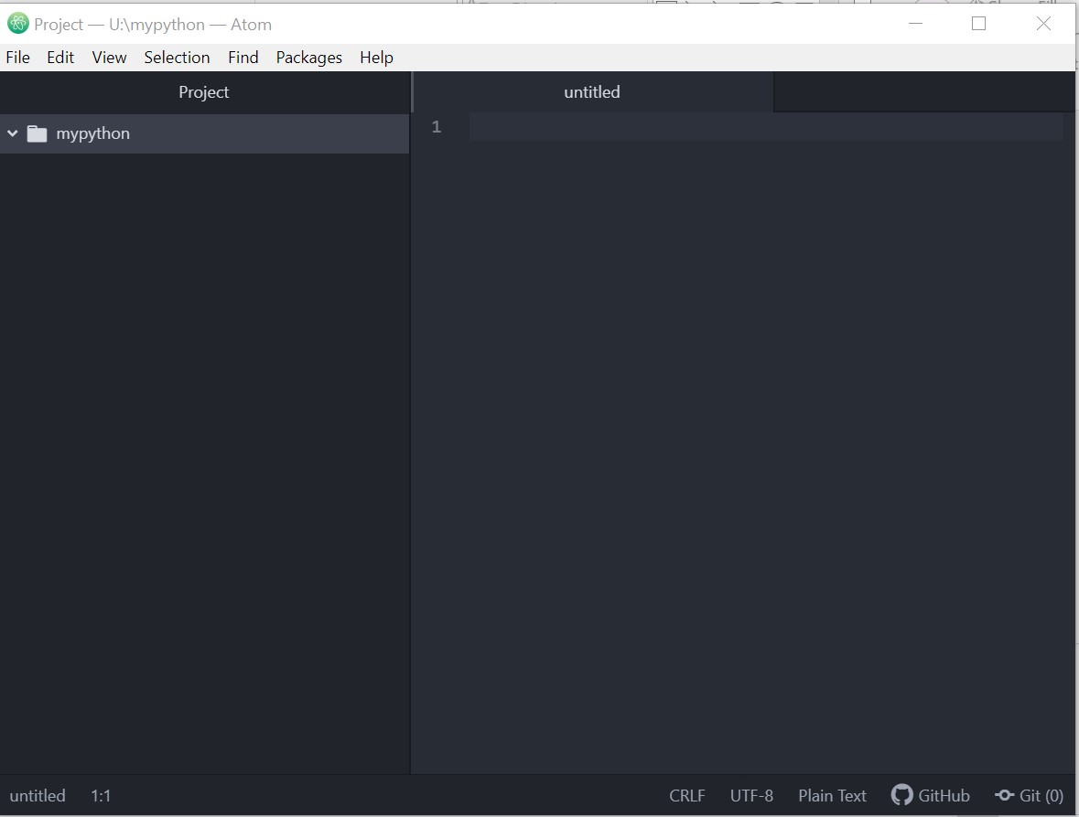
Write your first Python script
Notes:
Please do not reduce the font size as this is the recommended size for mobile phone users.
14

Slide 15
EXTRAS
Running Python programs in Atom
This is optional
In CMD prompt type
python -m pip install python-language-server[all]
Notes:
Please do not reduce the font size as this is the recommended size for mobile phone users.
15

